Slide 1
Introduction to field studies:
Leaf litter communities

Slide 2
Today’s Objectives:
Introduction to field experiments
Be able to describe the difference between a typical lab experiment and a field experiment
Be able to explain what makes a good field experiment
Learn basic leaf identification
Attempt to find invertebrates
Start planning deer exclosure study

Slide 3
History of Field Ecology
Started as making observations → making plausible explanations for the observations
“weak inference”
alternative explanations
Manipulative experiments and comparative studies increase statistical confidence

Slide 4
Differences between lab and field
Connell (1974):
Lab = experimenter controls everything and varies the one variable he or she is interested in
Field = all natural variables are allowed to fluctuate normally, while the variable of interest is controlled or manipulated by investigator

Slide 5
Lab vs. Field Continued
Both very useful
Only field experiments can capture complexities of nature
Interactions with other organisms
Natural variation in abiotic variables
Field requires knowledge of pre-existing conditions
Barnacle community structure
Plant communities present
Common animals in the area

Slide 6
Replication is especially important
Ecological systems are variable in time and space
Replication seeks to capture variation
“Is there an effect of the experimental treatment in despite the variation” among the study plots
Changes over time-
Previously could publish without much replication
Statistics very important, can check for ideal replicate number before experiment!

Slide 7
A Priori Testing
Early ecology had some issues with stating hypotheses after the fact
Modern Ecology more keen on statistical analysis and a priori hypothesis testing
Avoidance of pseudoreplication
Avoidance of quasi-experiments of human activity that examines the effect of human use without experimental intent
Knowledge of how prior conditions can affect ability to make actual “predictions”

Slide 8
You still need “control”!
In order to obtain strong inferences, and demonstrate an experimental effect
Example: allowing large granivores to move freely in control plots
What would the control be on an experiment testing the effects of deer exclosures on leaf litter invertebrate communities?

Slide 9
Leaf litter background
Important community- hospitable to large and small inverts and some small verts
Leaves insulate from heat and provide moisture, shelter and food
Detritus: decomposing organic matter, fed on by bacteria and fungi and small invertebrates (many are arthropods)
High diversity: can have thousands per square meter
Extracted with Berlese Funnel

Slide 10
Today’s task
Sample leaf litter to observe the prominent leaf litter type in this area
Check for inverts
Formulate hypotheses and framework for testing the effects of deer exclosures

Slide 11
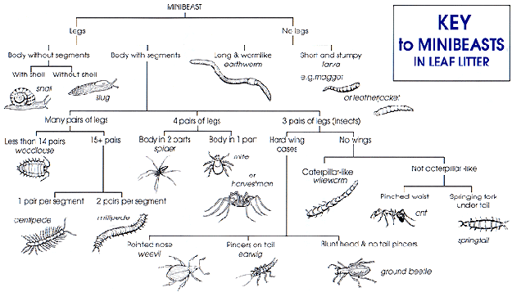
https://www.mpspride.org/uploaded/Waddell/Habitat/g-habitat-activities/nh-leaf-litter3.html

Slide 12
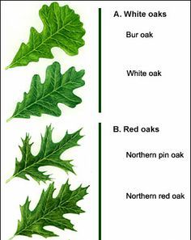
Main options, use field guides to help you

